Slide 1
What does this example show you about ApprovalTests?

Slide 2

What are you learning?

Slide 3

Notice any tricks in ?

Slide 4

Notice any tricks in ?

Slide 5
Why was the _____ in that location?

Slide 6


How could you change this example to explore some more?

Slide 7
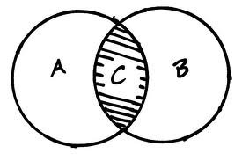
How does this example compare to the previous?

Slide 8

What is your current goal?

Slide 9

See any patterns?

Slide 10

State the Obvious

